Slide 1



TOWARDS A CONCEPTUAL MODEL FOR ADAPTIVITY IN SERIOUS GAMES
16.07.2012
Damir Ismailović, Barbara Köhler, Juan Haladjian, Dennis Pagano, Bernd Brügge
Chair for Applied Software Engineering
Technische Universität München
Adviser: Prof. Bernd Brügge (TUM, Munich)
Notes:
Hello.
My name is xxx.
Welcome to my presentation on “xxx”

Slide 2
Problem Definition
There is no form of education that is as effective as a professional human tutor (Bloom, 1984; Anderson et al., 1995)
Human tutors are highly adaptive (VanLehn et al., 2005; Niemiec/Walberg, 1987)
One level of complexity does not fit all (Schiefele/Schreyer, 1992)
Under-challenged learners are bored
Over-challenged learners are stressed
Individual human tutors not always available
=> Adaptive E-Learning and Adaptive Serious Games
Notes:
there is no form of education that is as effective as a professional tutor.
Humans are that effective because they are high adaptive to learners.
They can take care that learners reach their maximum potential for achievement.
And this potential is different for every learner individually.
It is important to individually consider every learner, because,
if learners are under-challenged they are bored.
If they are over-challenged, then motivation turns into stress and performance decrease.
The problem here is that individual tutors are not always available.

Slide 3
State of the Art in E-Learning
Macro-adaptive approach Selection of different alternatives of main components
Micro-adaptive approach Adapting instructions
Aptitude-treatment interaction approach Efficiency of treatments depends on the aptitude of students
Constructivistic-collaborative approach Learners collaborate
(Modritscher 2006)
Notes:
The main approaches in realizing adaptivity in e-Learning can be categorized as: the macro-adaptive approach, the micro-adaptive approach, the aptitude-treatment interaction approach, and the constructivistic-collaborative approach. (Mödritscher et al. 2004; Modritscher 2006) .
The Macro- Adaptive Approach targets the selection of different alternatives of main components like learning objectives (Mödritscher et al. 2004) as a kind of systematic guidance through learning content with adaptation to individual’s learning objectives, performance, and aptitude (Corno & Snow 1986).
Micro-Adaptive Approach addresses on adapting instructions
The Aptitude-Treatment Interaction Approach (ATI) states that there is no treatment that suits all students. Efficiency of treatments depends on the aptitude of students where students with higher prior knowledge should have more control over the learning process (Snow 1980). In the Constructivistic-Collaborative Approach the learner is the central component of the learning theory and is used where computer-based learning systems cannot reach the effectiveness of good human tutors. (Bloom 1984; Mödritscher et al. 2004)

Slide 4
State of the Art in Serious Games
State of the art serious games do not adapt dynamically to the user.
Adapt game elements and learning content independently
Behavior of game elements not focusing on learning activity
Distract the player from the learning
Missing link between learning content and game elements.

Slide 5
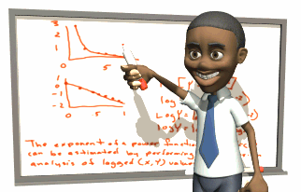
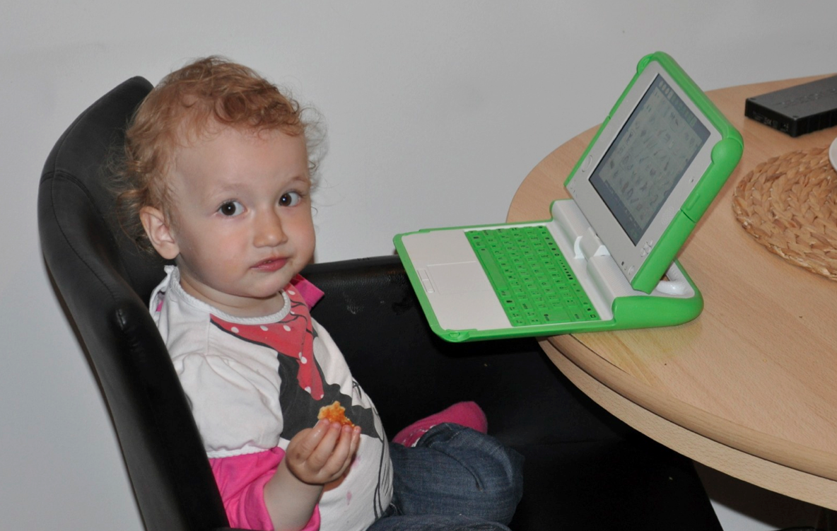
Research Questions
How do human tutors provide adaptivity in serious games?
How to formalize this activity?
Notes:
In order to analyse adaptivity in SGs, we need to start from beginning.
In order to take advantage of the human adaptivity behavior for serious games,
I analyzed this behavior in the folowing sense:
I tried to formalize the adaptive behavior of tutors,
In order to use it in the whole game and not just for virtual tutors.

Slide 6
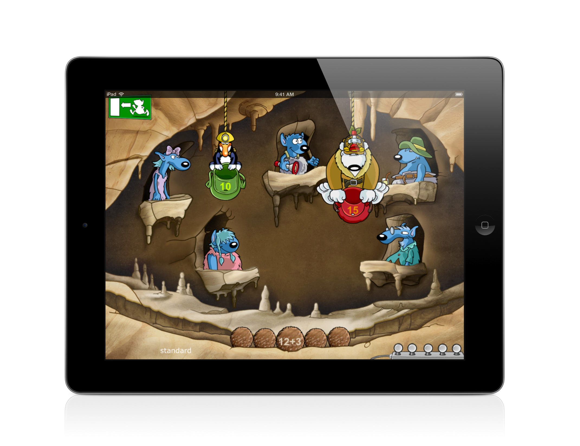
DASG Architecture
Monitoring
Characterization
Adaptive Intervention for Game Elements
Assessment Situations for Learning Content
DASG
Assessment Generator
Adaptive
Intervention
Monitoring
Characterization
Game Engine
Notes:
Additionally we went one step further, and defined a framework, that realizes this model as a combination of a static architecture and a dynamic playing process.
This is the static Framework architecture.

Slide 7
THANK YOU
Damir Ismailović
Chair for Applied Software Engineering
Technische Universität München
Notes:
Khan academy - results fit the adaptivity (Solomon Khan)
- slow students, can become best if they continue individually on learning content
Sumata Mitra: Education is a self organizing system, where learning is an emergent phenomenon.
- students adapt to each other (needs to be considered in future work)
Prof. Mandl: synthesis of learning and playing
Learning Theories: cognitivism + constructivism + social theories
Belloti: designed an experience-engine, where only tasks are adaptively selected.
---
- Modritscher did not considered games
- Prof. Mandl: For large knowledge structures this does not work
- Serious Games evaluation frameworks
- RETAIN ((Gunter et al., 2007)),
- FOUR-DIMENSIONAL ((De Freitas et al., 2010)),
- Balancing pedagogy, game and reality (Harteveld et al., 2007)
- they give guides to build good serious games
- to complicated and not applied, just theoretical constructs
- If games do not need to be adaptive, because they are really good, like (FoldIT)
---
future progression
I will do:
- Prototyping with adaptivity
- Social and connective development process
- Combination of adaptive and custructive steps
- Combine adaptive steps with steps that humans do together with an adaptive engine. (multi level adaptivity)
- this includes humans to the adaptivity process in games
Others can do:
- make compelling games
- research for ways to build efficient and large knowledge structures
- AI methods in adaptivity
- adaptivity to educators and parents
- adaptivity can also be integrated to work, by gamifying the work
- adaptivity of user interfaces

Slide 8
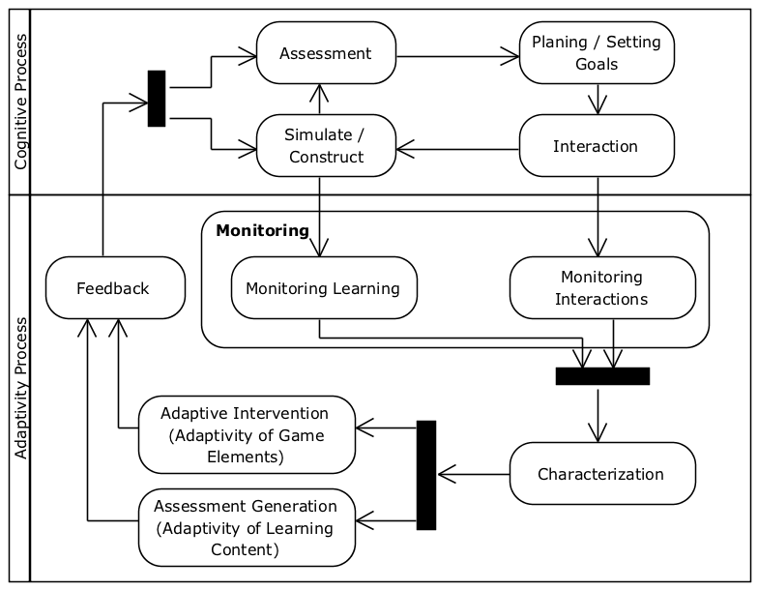
Dynamic Adaptivity Process
Monitoring the player
Characterize the player
Adaptive Steps
Adaptive Intervention for Game Elements
Generate Assessment Situations for Learning Content
Notes:
Based on this architecture DASG defines the adaptivity process for playing a serious game in the following way.
The player in the first step, plans the solution of a task, deciding, what actions are necessary for the solution.
When the learner executes these actions the game provides a feedback that can be interpreted in a way related to the task and domain.
Then the learner uses this feedback to decide, whether the solution is correct or not.
The interesting point here is that the feedback can be indirect, so that the user can interpret it according to own subjective meanings.
The adaptivity process is monitoring the execution steps: simulate/construct and interaction.
Using this date the characterization process builds the profile that is used in order to adapt game elements and content.
Both are combined in a single feedback continuously to the user.

